Slide 1
Clustered Fingerprinting and Tracking in High-Density Internet of Things (IoT) Environments
CSG Master Thesis: Midterm Presentation
Supervisor: Katharina Müller

Slide 2
Content
Thesis Motivation
BLE Introduction
Thesis Goals
Related Work
Research Gap
Status and Future Work
Q&A

Slide 3
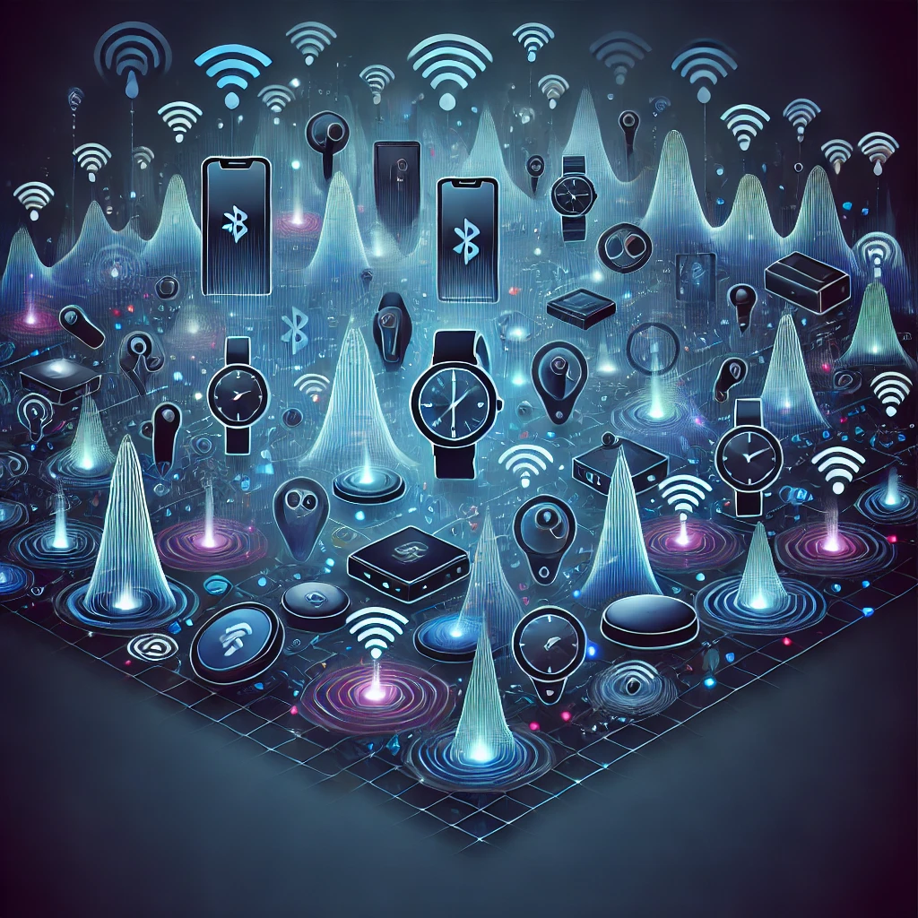
Thesis Motivation
Many BLE-enabled IoT devices
Dense and highly complex communication networks
Image generated by ChatGPT 4o

Slide 4
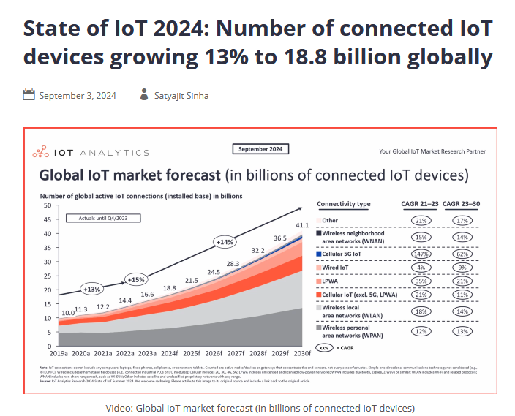
Thesis Motivation
Image generated by ChatGPT 4o
IoT Statistics by IoT Analytics
https://iot-analytics.com/number-connected-iot-devices/

Slide 5
Thesis Motivation
Many BLE-enabled IoT devices
Dense and highly complex communication networks
Can we identify:
Devices?
Groups of connected Devices?
→ What if we can identify and track groups of connected devices? Are BLE devices secure?
Image generated by ChatGPT 4o

Slide 6
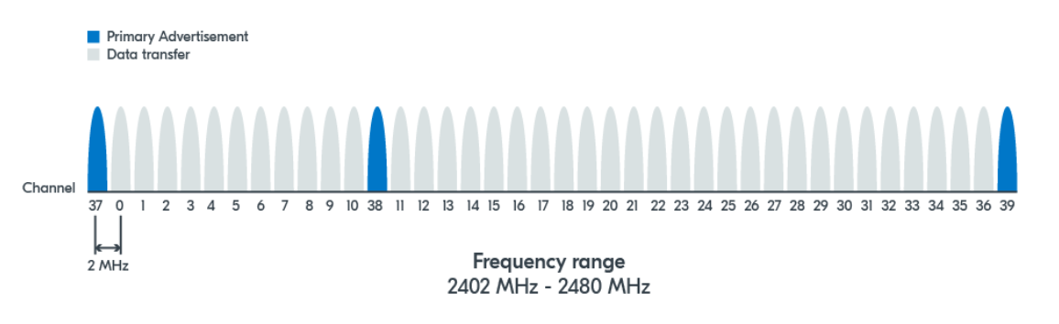
BLE Introduction
Bluetooth Low Energy
BLE operates on 40 channels
Bluetooth Classic has 79 channels
Image from NordicSemi
https://academy.nordicsemi.com/courses/bluetooth-low-energy-fundamentals/lessons/lesson-2-bluetooth-le-advertising/topic/advertising-process/

Slide 7
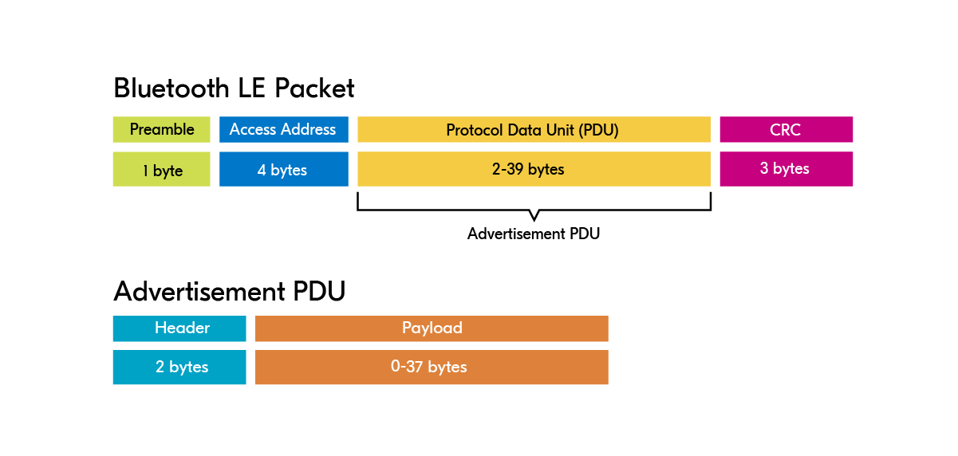
BLE Advertisement Packet
Image from NordicSemi
https://academy.nordicsemi.com/courses/bluetooth-low-energy-fundamentals/lessons/lesson-2-bluetooth-le-advertising/topic/advertisement-packet/

Slide 8
Thesis Goals
Create a clean dataset of several connected BLE devices (recorded together)

Slide 9
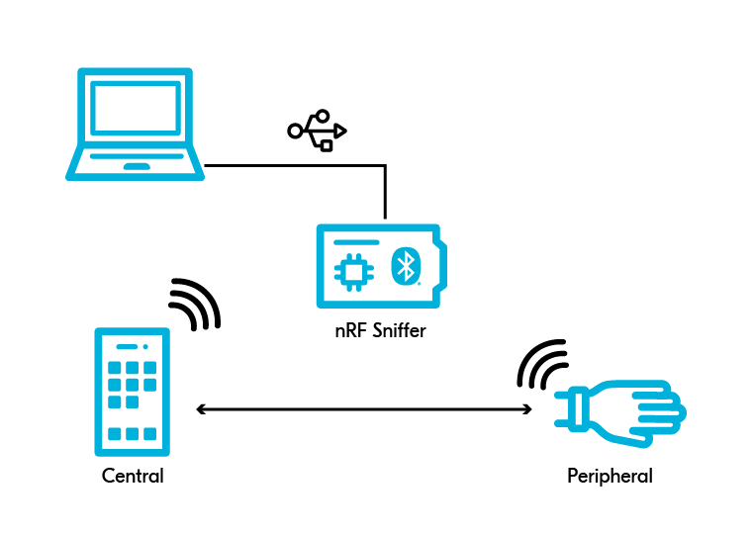

Dataset Capturing
Laptop as capturing device:
nRF Sniffer attached via USB
Wireshark and BLE plugin running
BLE devices included:
Mobile phone, ear-buds, tag (all Samsung)
Connected via Bluetooth
Data extraction:
Select relevant columns
Create .csv afterwards
Image from NordicSemi
https://academy.nordicsemi.com/courses/bluetooth-low-energy-fundamentals/lessons/lesson-6-bluetooth-le-sniffer/topic/sniffing-bluetooth-le-packets/

Slide 10
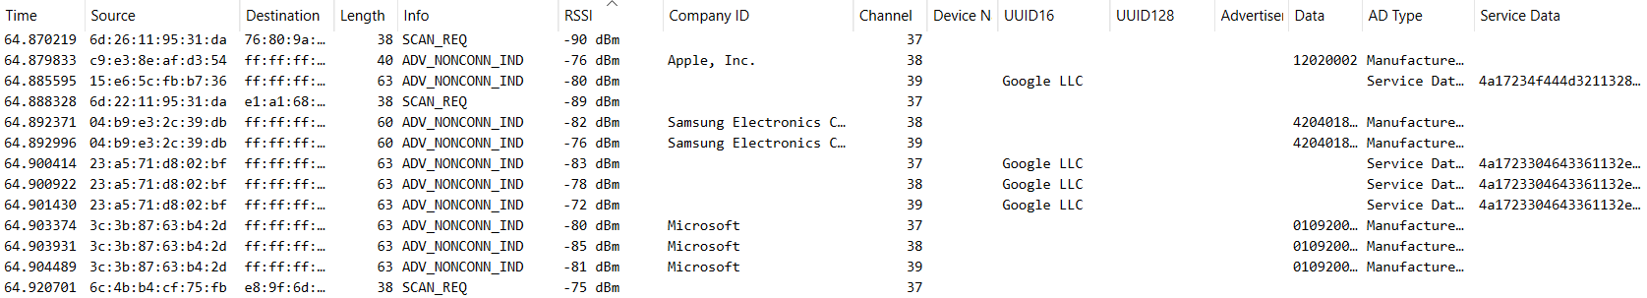
Wireshark Profile and Columns
Image of Wireshark UI during capturing

Slide 11
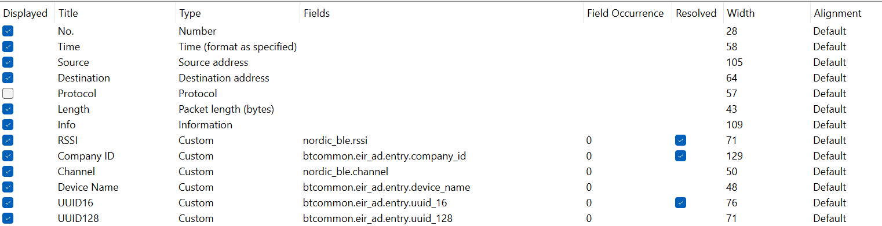
Wireshark Profile and Columns
Image of Wireshark UI profile preferences
Image of Wireshark UI during capturing

Slide 12
Thesis Goals
Create a clean dataset of several connected BLE devices (recorded together)
Create a fingerprint of that device group/cluster and train with an algorithm (ML, DL, …)

Slide 13
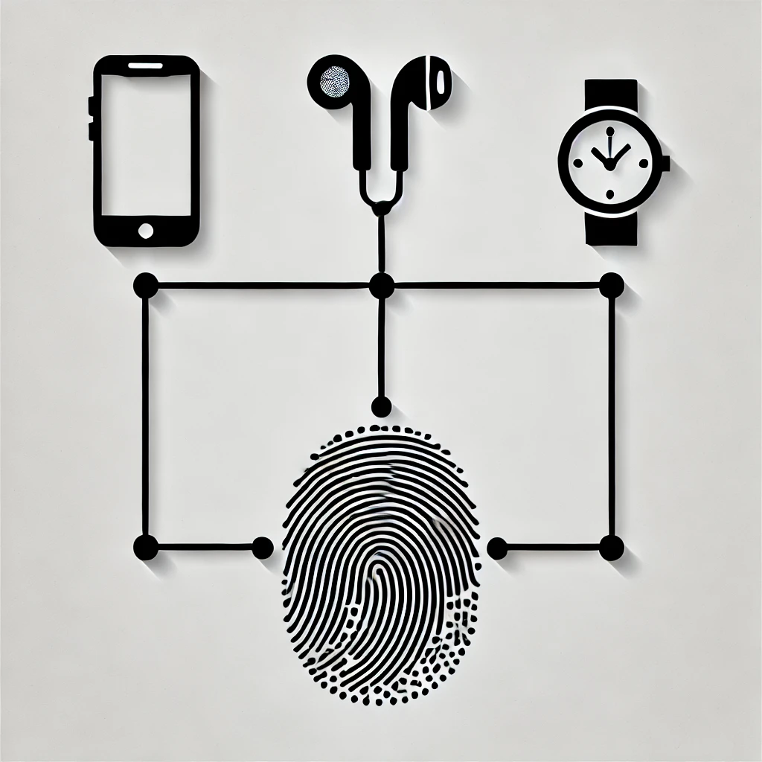
Fingerprinting
Accumulation of information and correlating data to identify and detect digital components
Features and vectors that define a fingerprint can be used to train models
Image generated by ChatGPT 4o

Slide 14
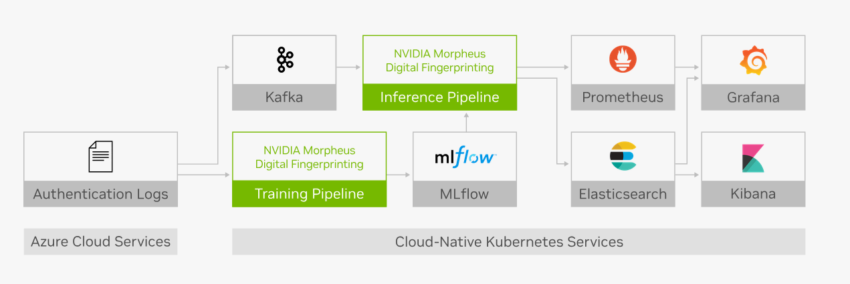
NVIDIA Morpheus: Fingerprinting in Cybersecurity through Anomaly Detection
Image from NVIDIA
https://www.nvidia.com/en-us/ai-data-science/ai-workflows/digital-fingerprinting/
Notes:
Anomaly Detection

Slide 15
Thesis Goals
Create a clean dataset of several connected BLE devices (recorded together)
Create a fingerprint of that device group/cluster and train with an algorithm (ML, DL, …)
Apply the algorithm in a high-density IoT environment → find and label the specified group of connected devices

Slide 16
Evaluation
Overall goal: The predefined connected devices should be grouped and identified by the algorithm
First step: apartment → little interference
Second step: crowded public place → lots of interference
Generalizability of the developed approach?
How well did the approach work?

Slide 17
Related Work
Tracking and tracing of BLE devices
Often application-related → COVID-19 for example
Privacy concerns
BLE fingerprinting and device identification
Many single device approaches
Different characteristics: layer specific, manufacturer, …
Device localization with beacons and RSSI
Use several nodes to triangulate device location
Angle- or layout-based calculations

Slide 18
Related Work
ML & DL advancements
ML: Decision Tree, Random Forest
DL: Artifical neural networks (ANNs) and Convolutional neural networks (CNNs)
Clustering
k-means, DB-SCAN, affinity propagation etc.
not always BLE-related
Linking BLE devices
Assign them to a user carrying multiple IoT devices through pathways
Packet size and timing pattern to detect device communication

Slide 19
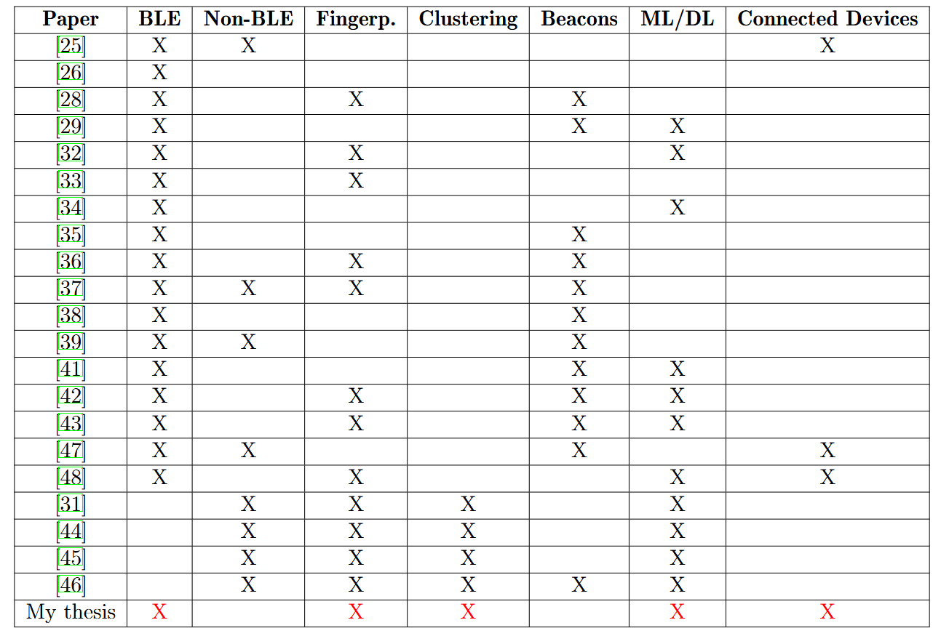
Research Gap
Clustered fingerprinting in BLE non-existent
Researchers either use beacon approaches or only identify single devices

Slide 20
Status and Future Work
Feasibility Testing:
Exclusion of certain devices (Smart Watch, Fitbit)
Three hour test dataset with three devices
Analysis script with manual labeling process
Next steps:
Find good feature vectors → Intervals? Aggregate values?
More data(sets)
Trial and error (and hopefully success)

Slide 21
Q&A

